Slide 1
Embedding Co-Assay Data in the Same Space
Presenter:
Songyang Cheng
Mentor:
Zakieh Tayyebi,
Dr. Christina Leslie

Slide 2

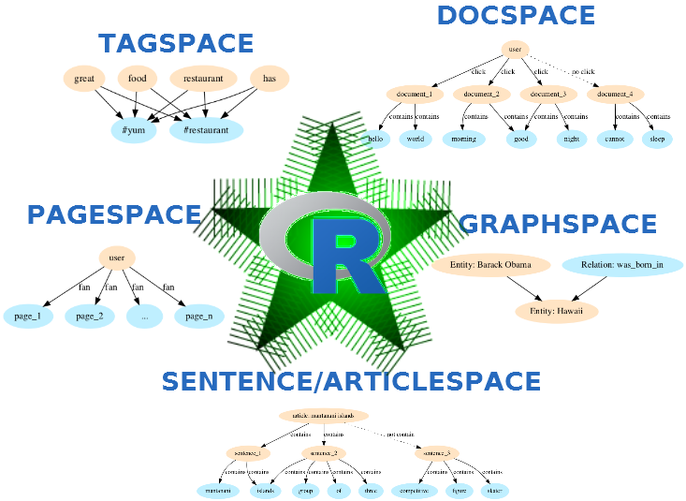
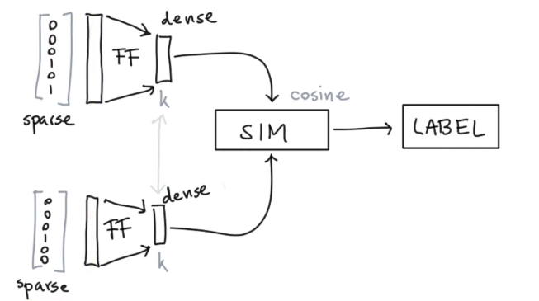
Underlying Natural Language Processing(NLP) Algorithm

Slide 3
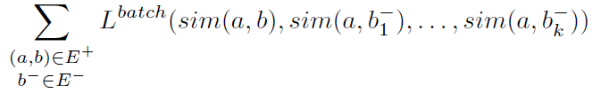
Loss Function
K negative sampling

Slide 4
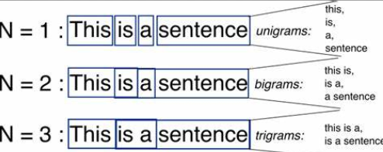
ngram

Slide 5
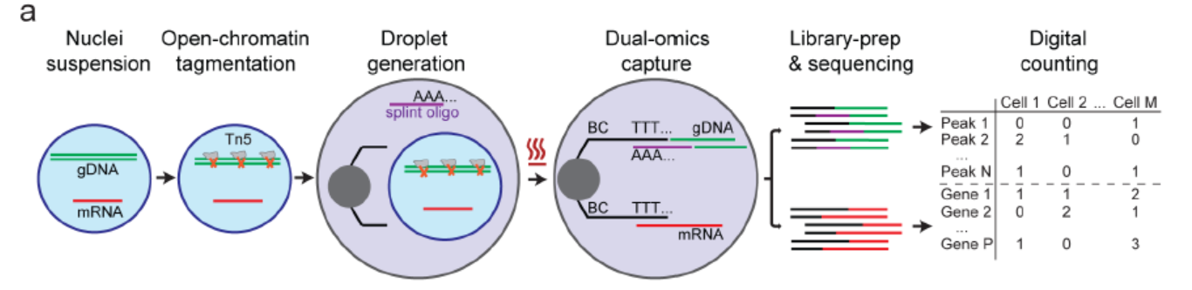
Co-assay Technique
Droplet-based single-nucleus chromatin accessibility and mRNA expression sequencing (SNARE-seq), a method that can link a cell’s transcriptome with its accessible chromatin for sequencing at scale
Specifically, accessible sites are captured by Tn5 transposase in permeabilized nuclei to permit, within many droplets in parallel, DNA barcode tagging together with the mRNA molecules from the same cells.

Slide 6
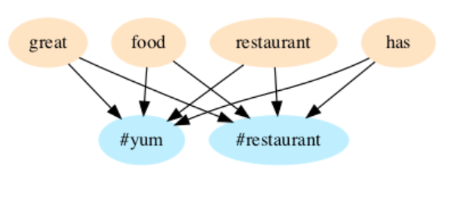
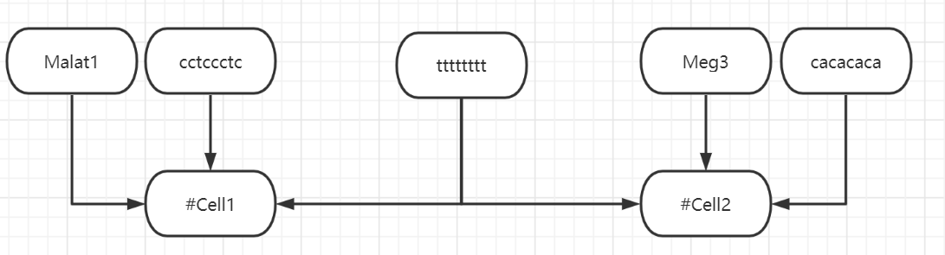
Tag Space

Slide 7
Procedure
scATAC-seq:
run CellSpace to process sc-ATAC data output to dna.txt.
scRNA-seq:
process sc-RNA data and output to rna.txt.
Combined:
Concat rna.txt and dna.txt into one file merge.txt.
StarSpace:
Run StarSpace. Tuning Hyperparameters.
Downstream Analysis:
Clustering and Pseudo-time analysis.

Slide 8
scATAC-seq (CellSpace)
Processed a barcode file containing cell names, a count matrix file containing cell*peak, and a peak file containing start and end positions for each peak in its chromosome.
#09I_TCCAACTCAGAG #09J_TACTTGGACACC #09E_CACTTGAAGTCT #09C_CCTCGATCGAGT #09J_AGGTTTGACCTC ttgccttc tgccttct gccttctg ccttctgc cttctgct ttctgctt tctgcttc ctgcttcg tgcttcgc gcttcgcc cttcgcct ttcgcctc tcgcctcc cgcctcca gcctccag cctccagc ctccagct tccagctt ccagcttc

Slide 9
scRNA-seq
Processed a barcode file containing cell names, a count matrix file containing cell*gene, and a file containing genes.
Lingo2:20 Lsamp:21 Dlg2:31 Celf2:32 Nrxn3:34 Lrrtm4:35 Kcnip4:41 Meg3:51 Ptprd:64 Malat1:205 #09A_CAGCCCCGCCTT
Notes:
The second part is to process rna data. We load the data as Seurat objects, and normalize this data. We sample genes for cells based on the counts and assign weights. If these genes are more expressed in certain cells, the weights are higher. In addition, the weights of genes are sorted in ascending orders.

Slide 10
Data
Chen S, Lake BB, Zhang K. High-throughput sequencing of the transcriptome and chromatin accessibility in the same cell. Nat Biotechnol 2019 Dec;37(12):1452-1457. PMID: 31611697 GSE126074
AdBrainCortex
10,309 cells
33,160 genes
244,544 peaks
P0_BrainCortex
5,081 cells
19,322 genes
229,429 peaks

Slide 11
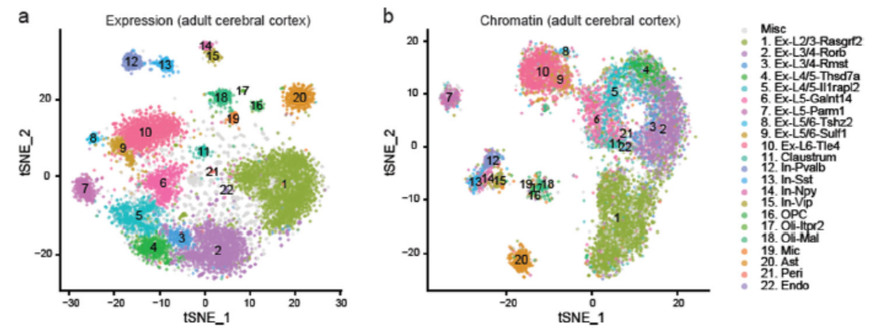
Ad data
Peaks fewer than overall 5 counts or expressing in more than 10% of cells were removed.
In chromatin accessibility data, Cells were labeled with the same color codes for cell types identified by the linked expression data.

Slide 12
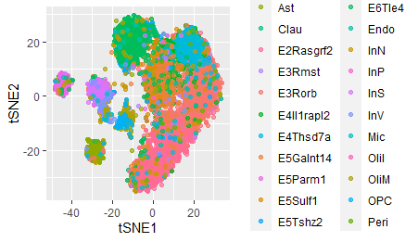
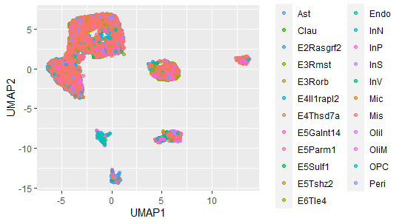
Reproduction for ATAC data

Slide 13
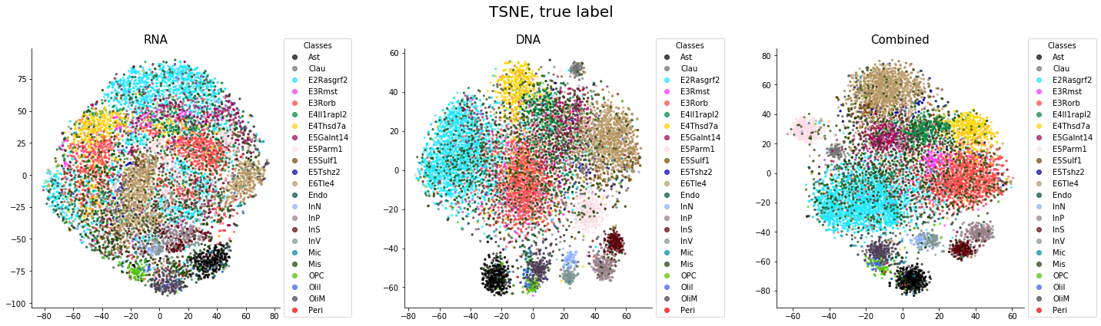
Embedding=15
scRNA
scATAC
Co-Embedding

Slide 14
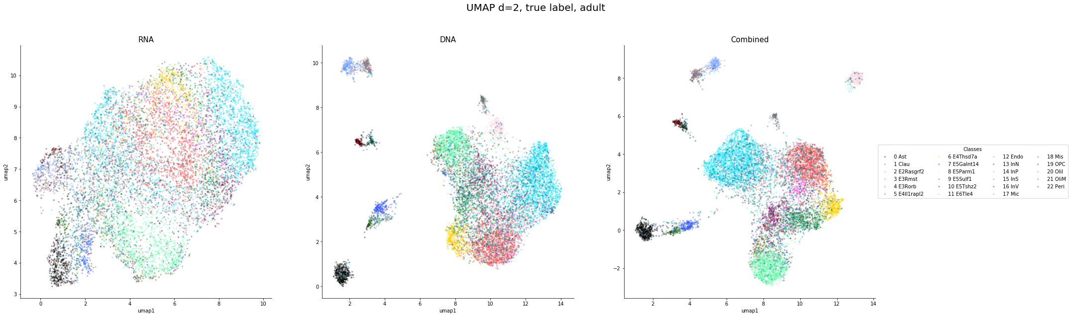
scRNA
scATAC
Co-Embedding

Slide 15
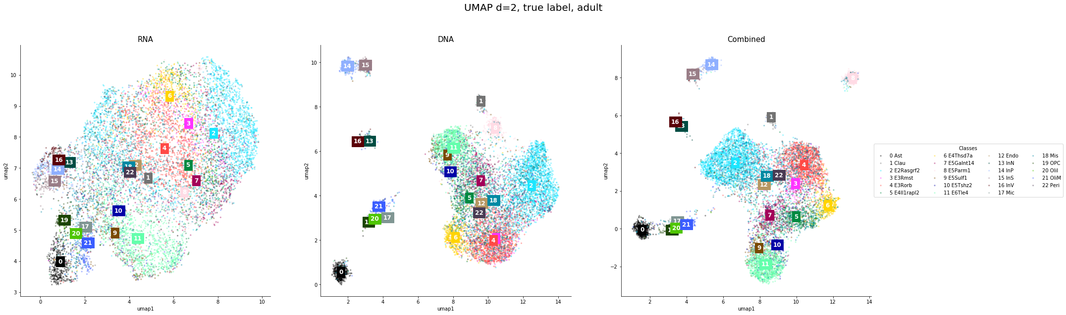
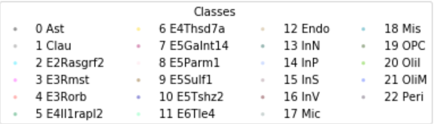
scRNA
scATAC
Co-Embedding

Slide 16
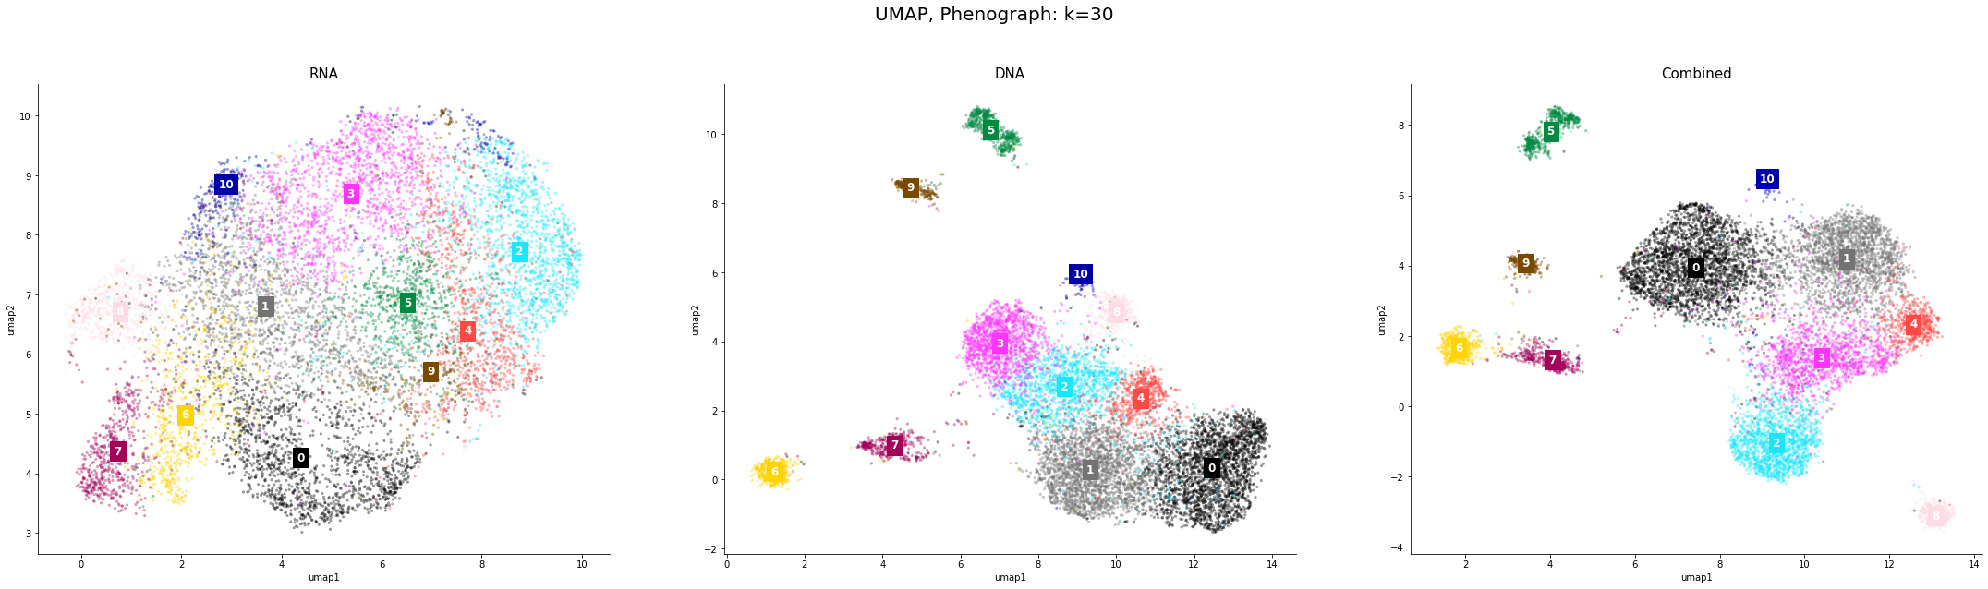
Downstream Analysis: Phenograph
scRNA
scATAC
Co-Embedding

Slide 17
AMI
Adjusted Mutual Information (AMI) is an adjustment of the Mutual Information (MI) score to account for chance.
This metric is independent of the absolute values of the labels: a permutation of the class or cluster label values won’t change the score value in any way.
AMI(U, V) = [MI(U, V) - E(MI(U, V))] / [avg(H(U), H(V)) - E(MI(U, V))]

Slide 18
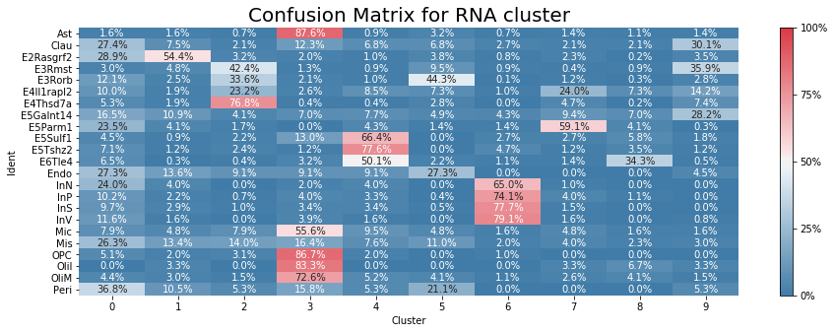
Phenograph: scRNA-seq
The AMI score is 0.345

Slide 19
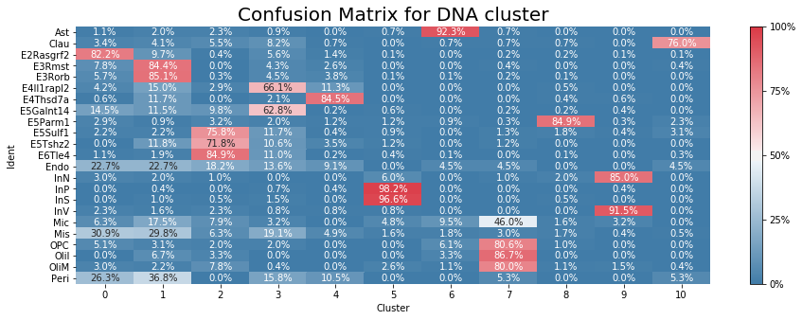
Phenograph: scATAC-seq
The AMI score is 0.543

Slide 20
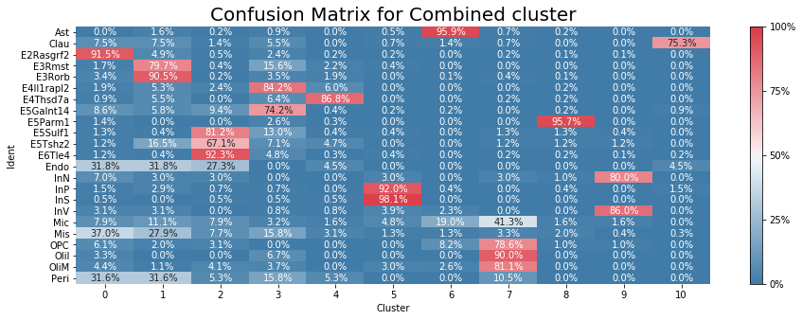
Phenograph: Co-Embedding
The AMI score is 0.614

Slide 21
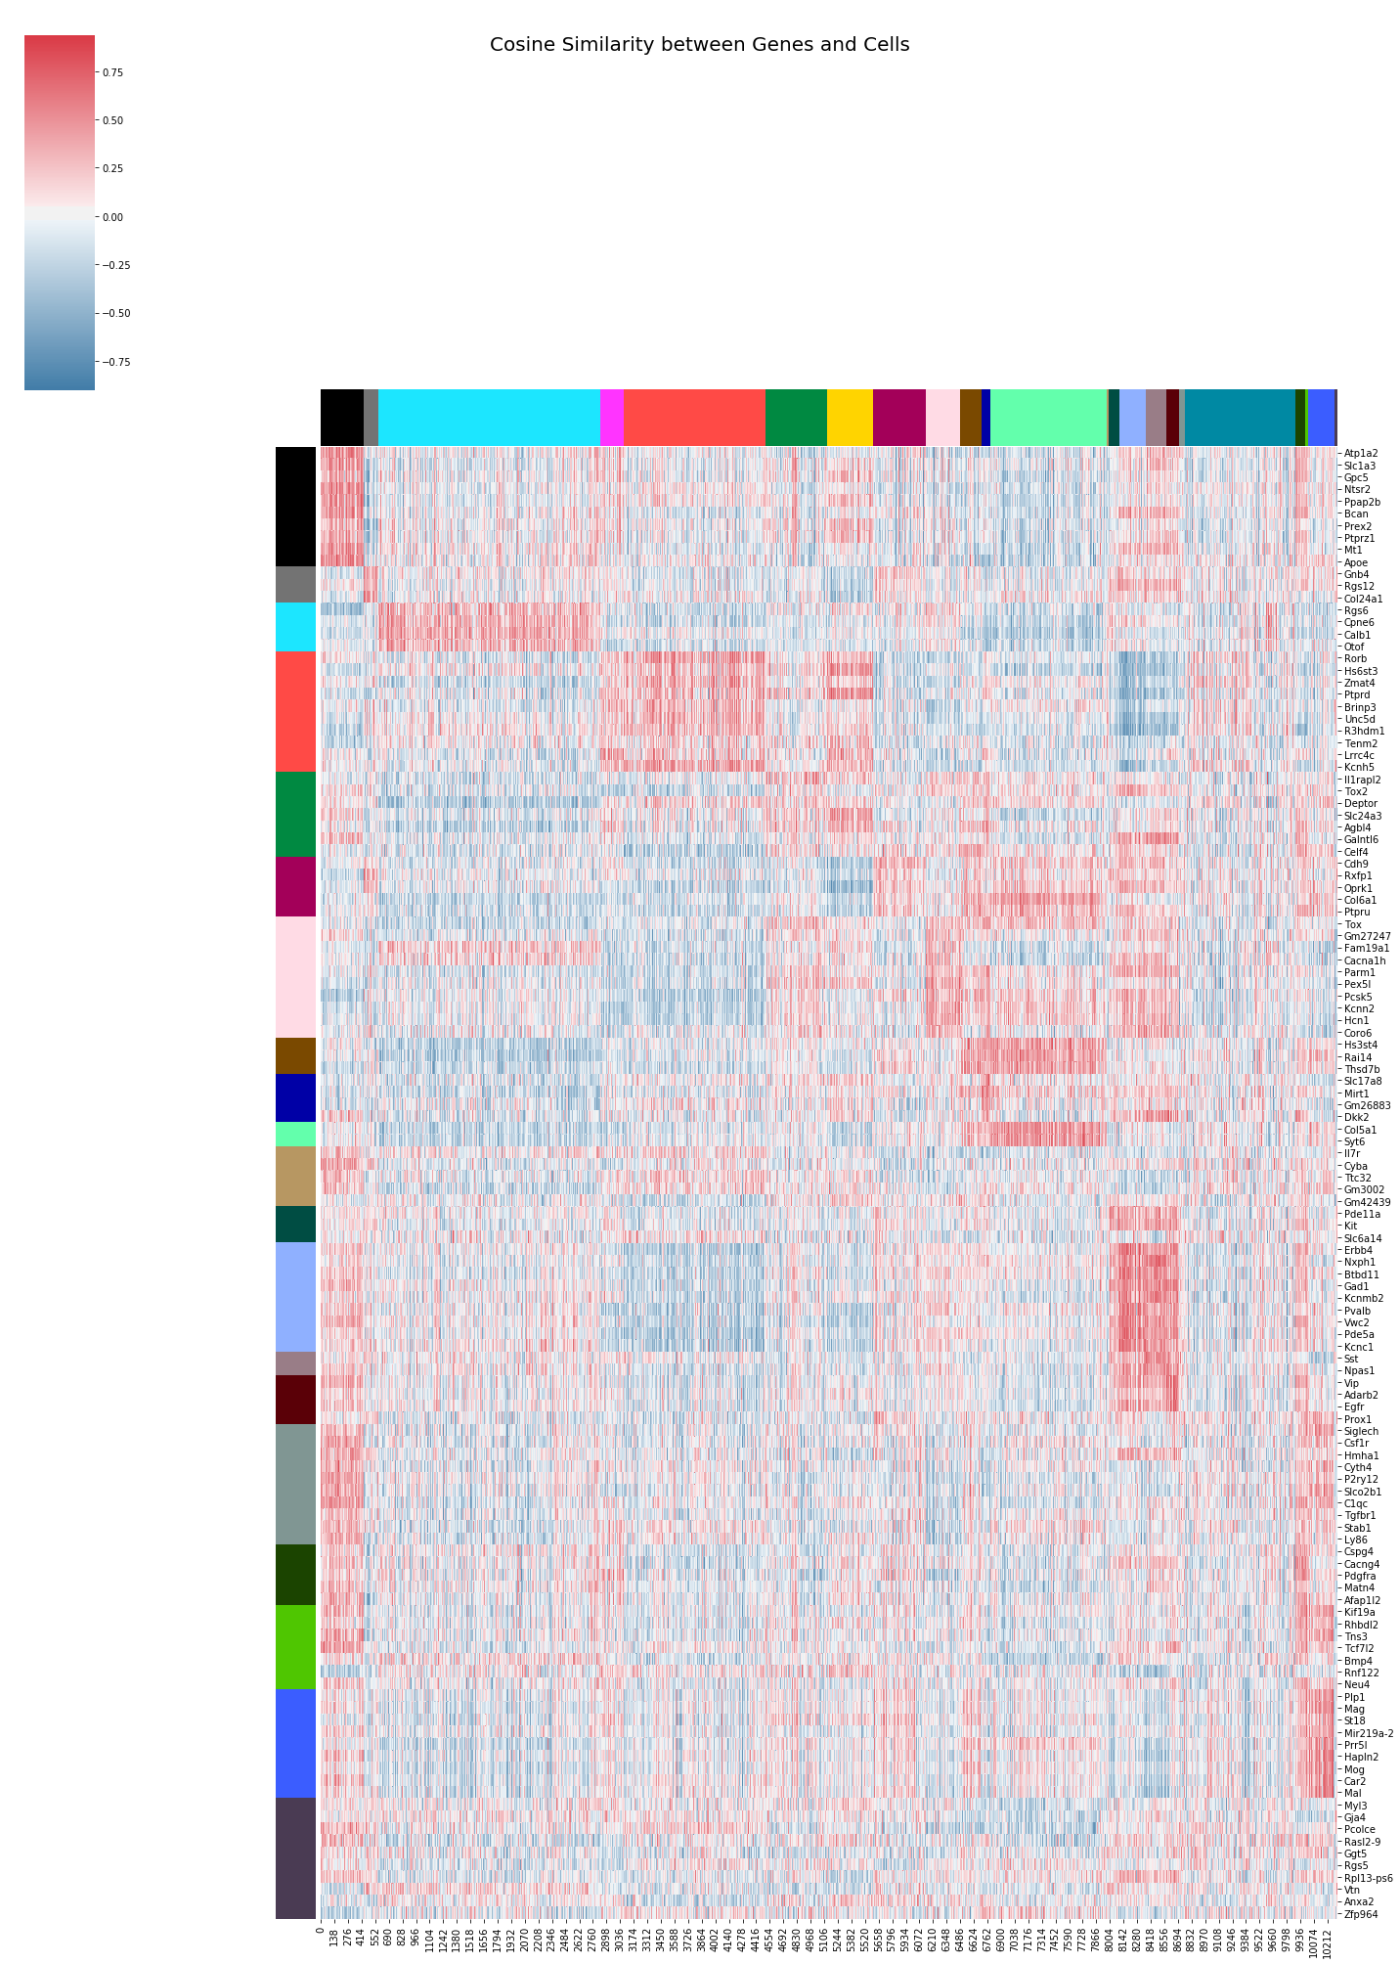

Slide 22
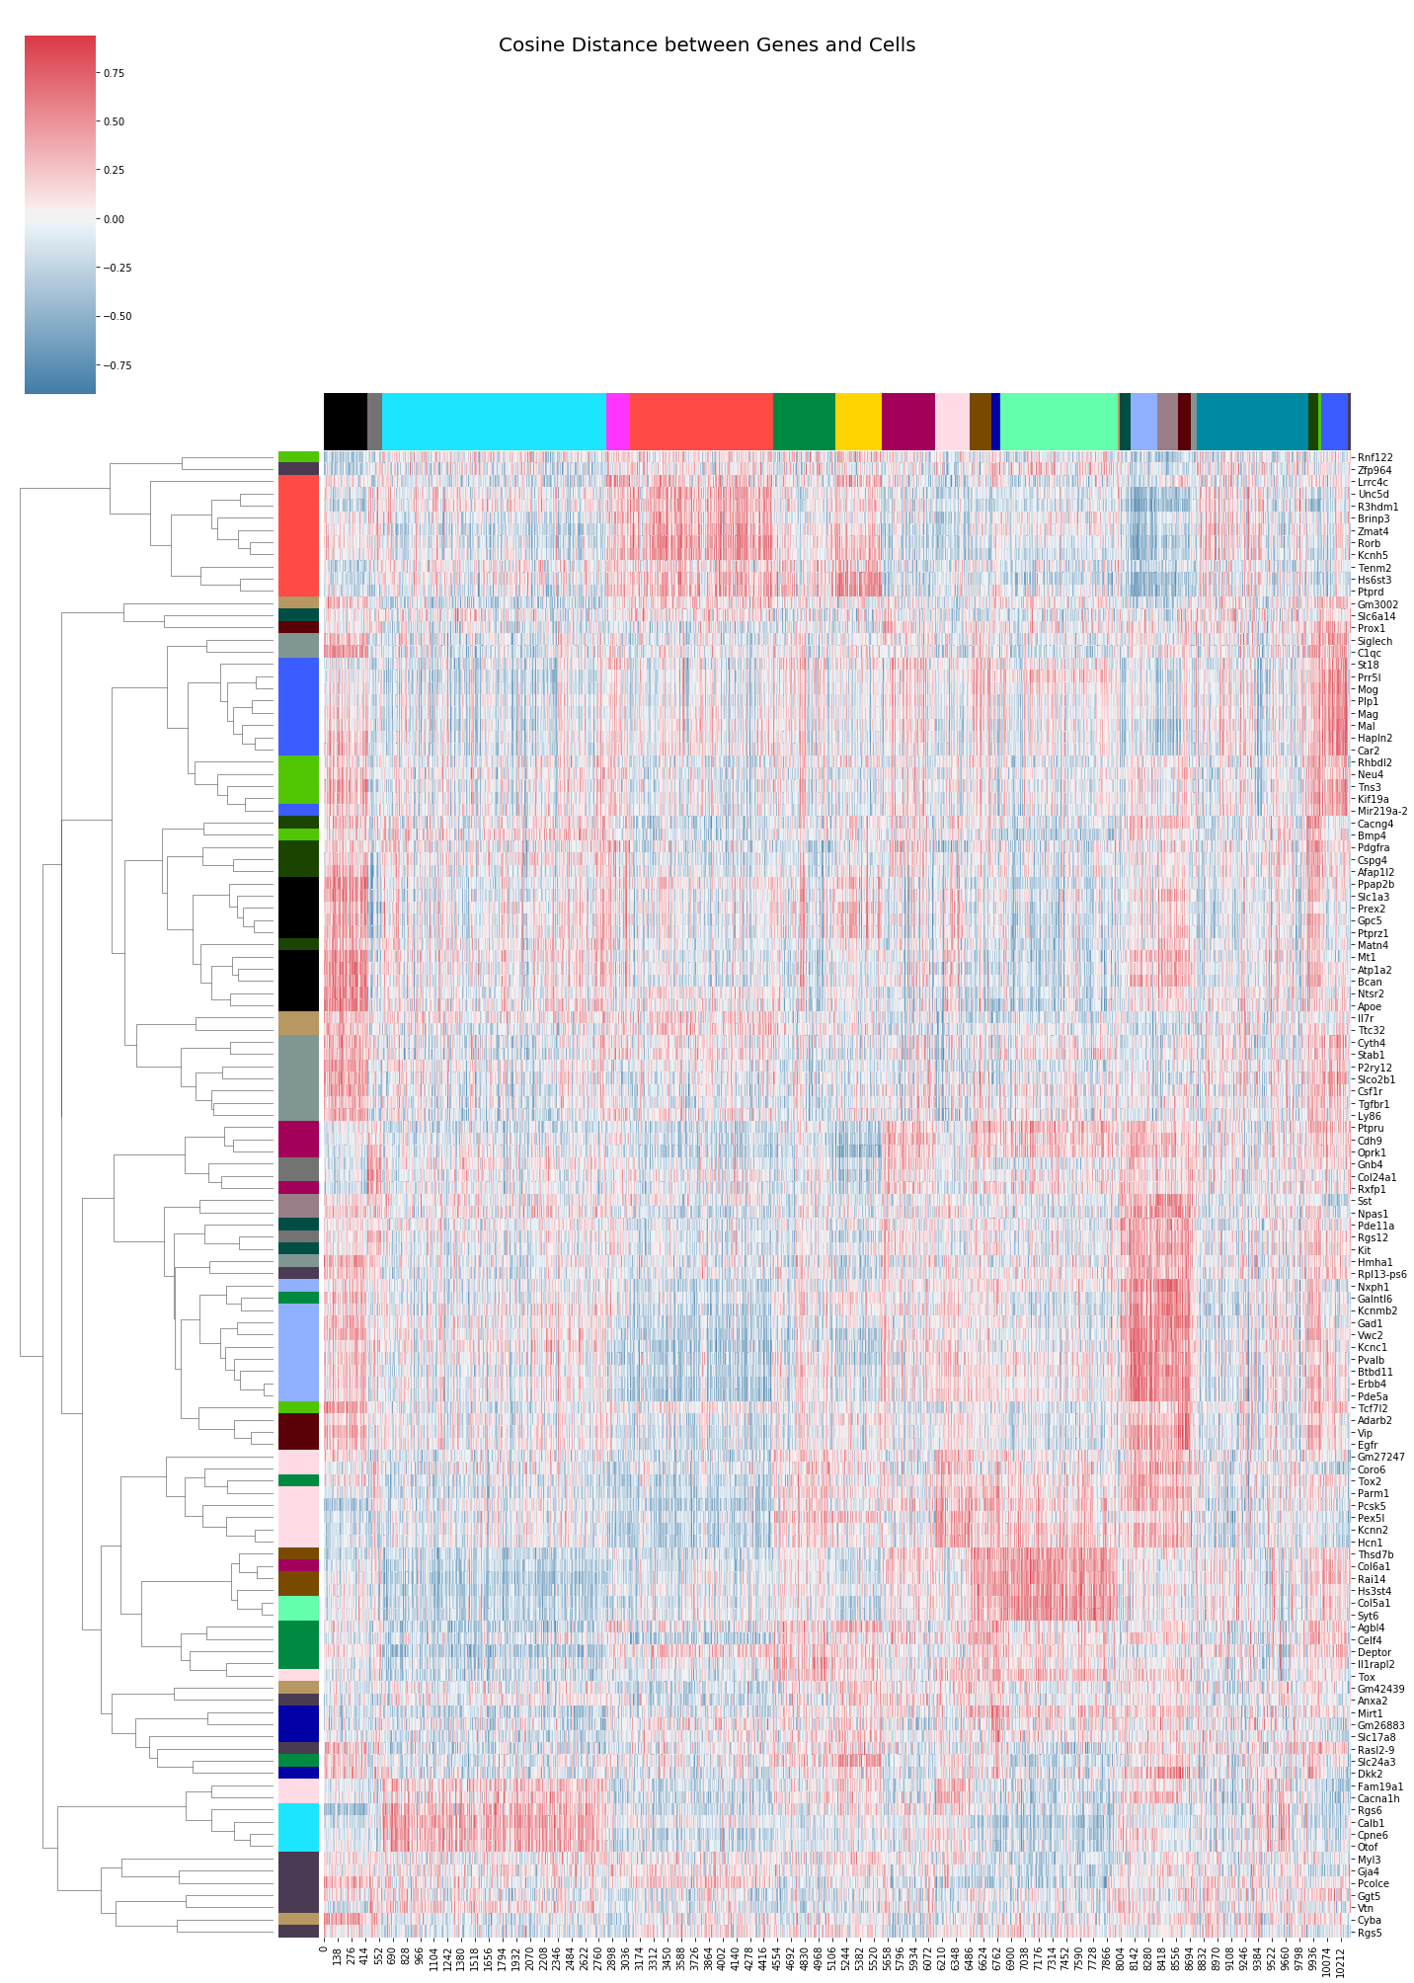

Slide 23
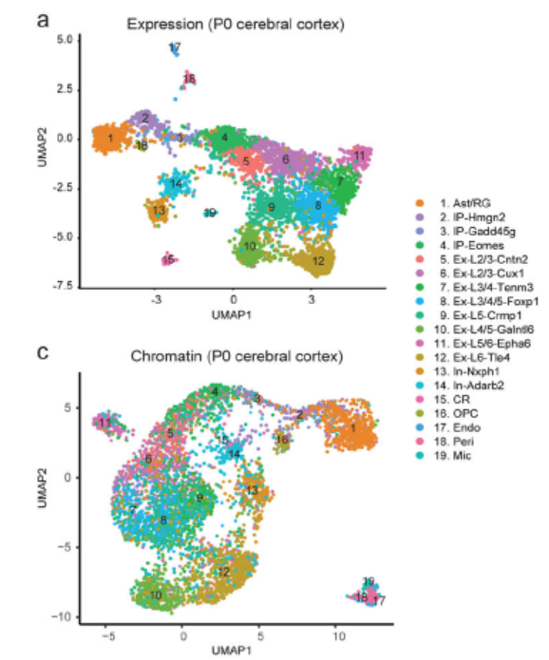
Neonatal (p0)

Slide 24
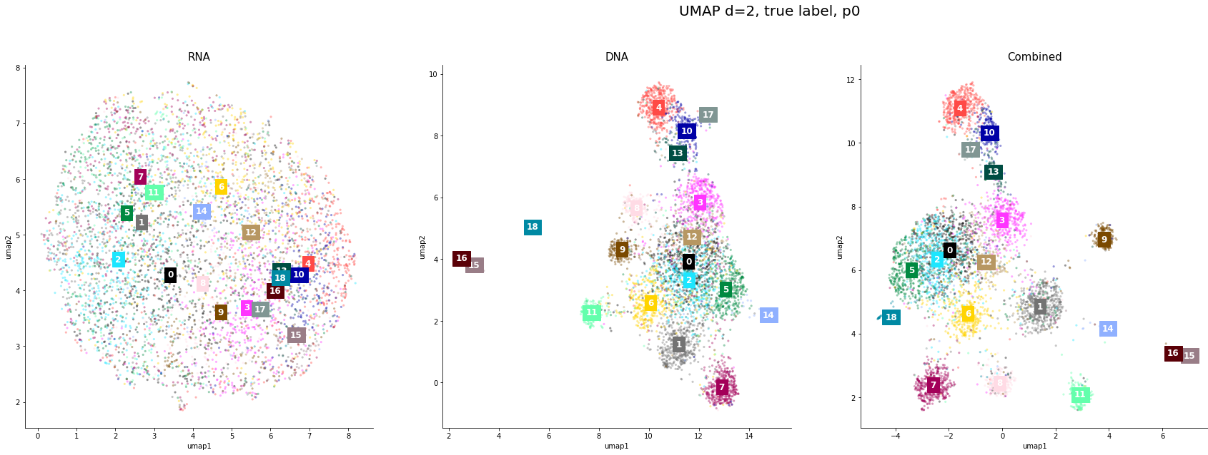
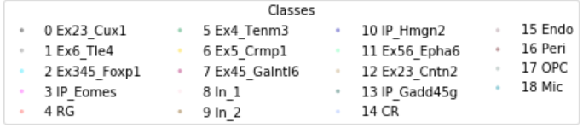
scRNA
scATAC
Co-Embedding
IP
IN
Ex

Slide 25
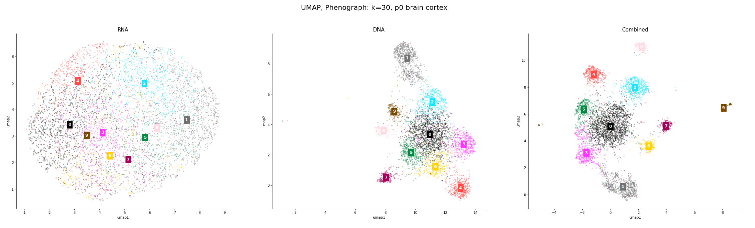
Phenograph
scRNA
scATAC
Co-Embedding

Slide 26
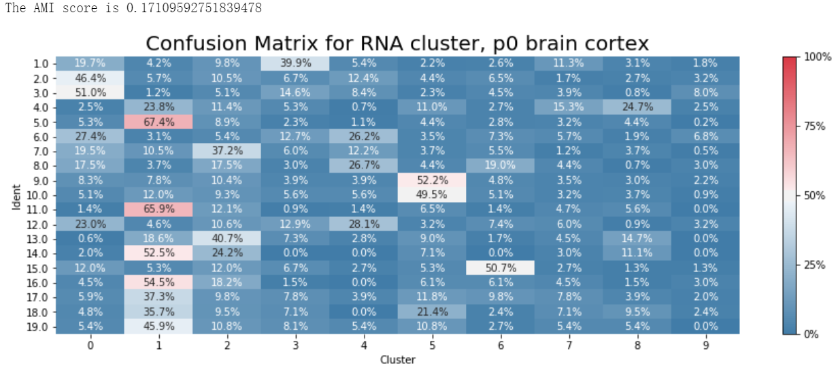
Phenograph: scRNA-seq

Slide 27
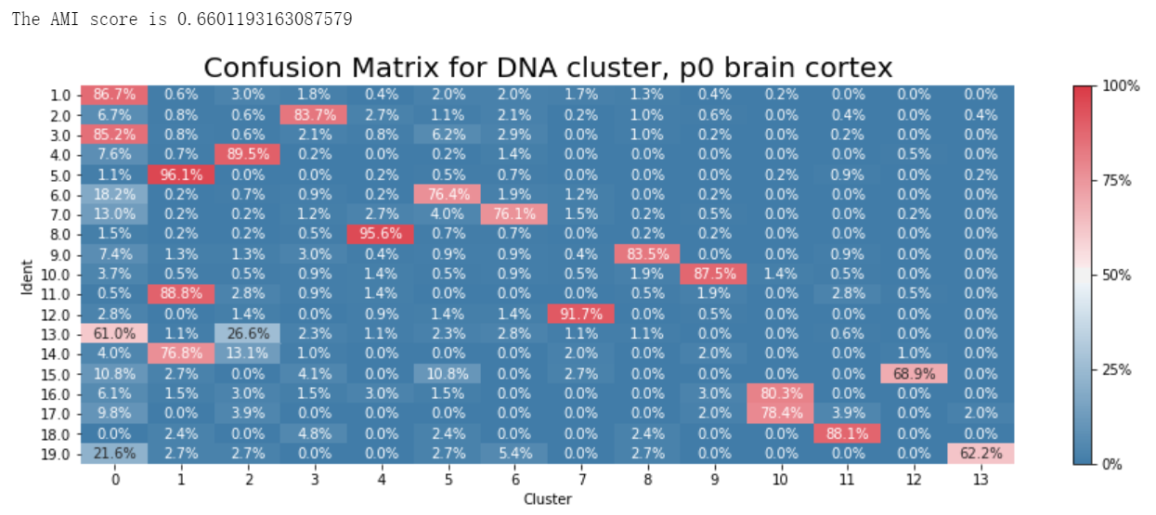
Phenograph: scATAC-seq

Slide 28
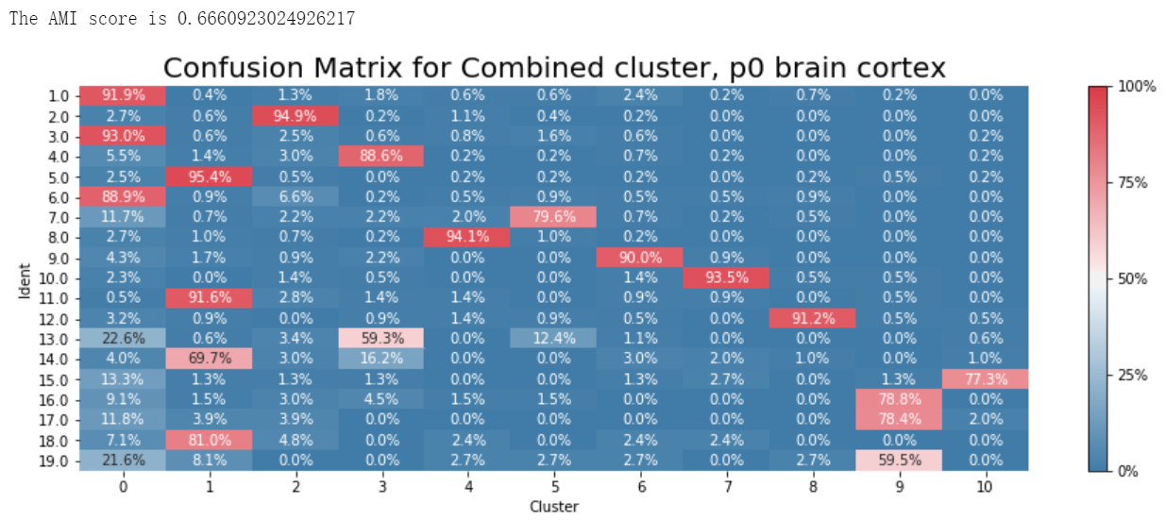
Phenograph: Co-Embedding

Slide 29
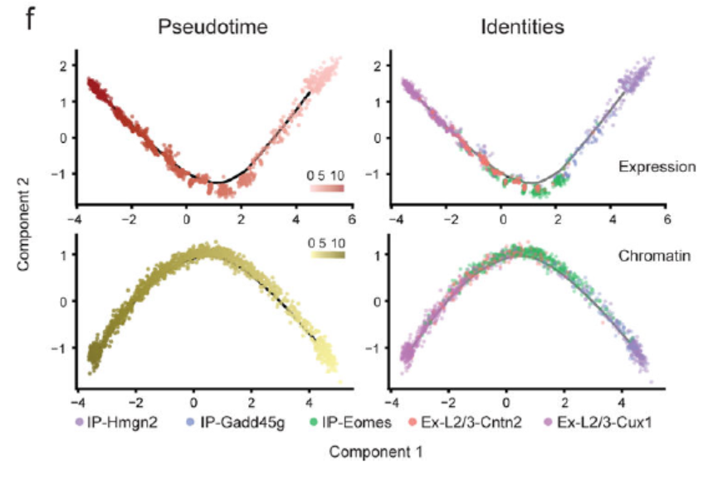
Pseudo-time Analysis
Pseudo-time trajectory constructed with SNARE-seq expression and chromatin accessibility.
Transition from intermediate progenitors to upper layer excitatory neurons
Monocle
(an analysis toolkit for single-cell RNA-seq)

Slide 30
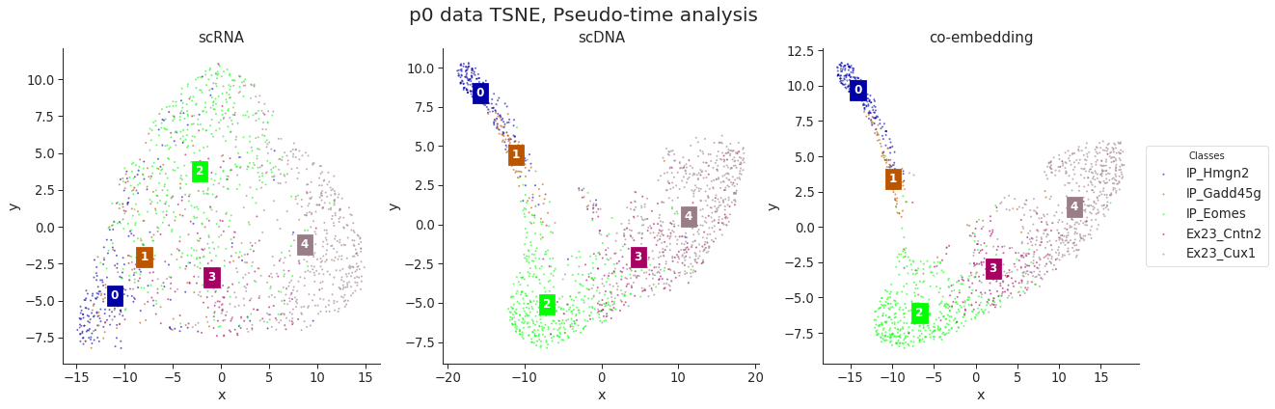
TSNE

Slide 31
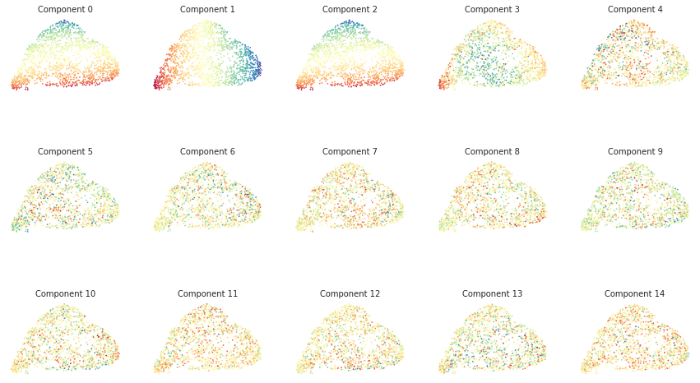
plot_diffusion_components scRNA

Slide 32
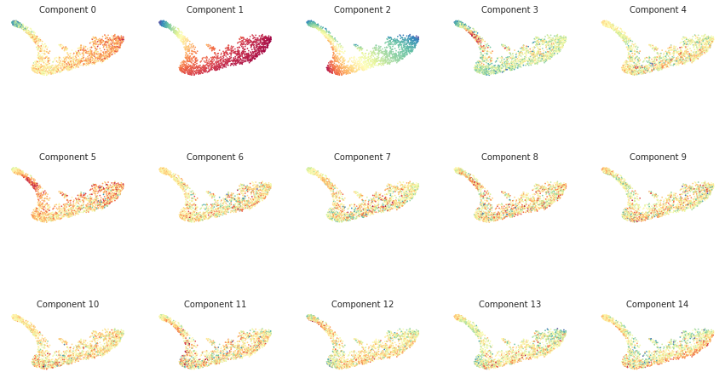
plot_diffusion_components scDNA

Slide 33
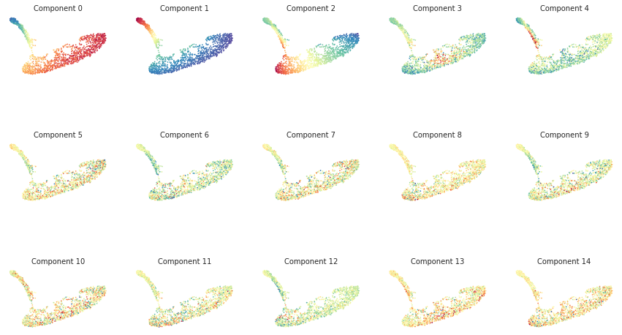
plot_diffusion_components co-Embedding

Slide 34
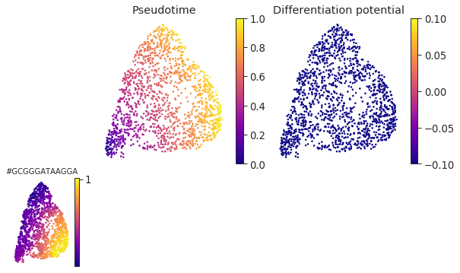
Palantir Result (scRNA)

Slide 35
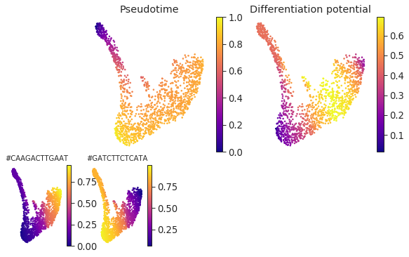
Palantir Result (scDNA)

Slide 36
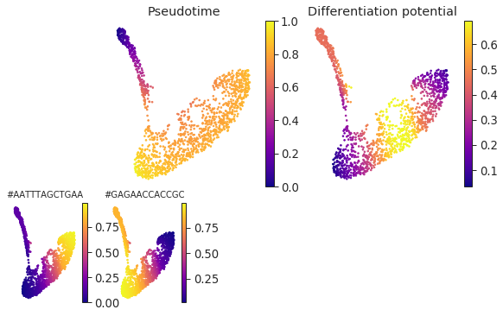
Palantir Result (co-Embedding)

Slide 37
Future Direction
Peak-peak links & peak-gene links
Compare the embedding of genes and transcription factor motifs
Explore different parameters for the StarSpace and CellSpace model
Extend to other datasets

